Slide 1
Introduction to Business Analytics
Data Scientist Vs Data Engineer Vs Business Analyst UNIT 1 Part 2

Slide 2
Data Scientist Vs Data Engineer Vs Business Analyst
Data Scientist
A data scientist is a specialist who applies their expertise in statistics and building machine learning models to make predictions and answer key business questions.
A data scientist still needs to be able to clean, analyze, and visualize data, just like a data analyst. However, a data scientist will have more depth and expertise in these skills, and will also be able to train and optimize machine learning models.
Notes:
The Data Scientist In Depth
The data scientist is an individual who can provide immense value by tackling more open-ended questions and leveraging their knowledge of advanced statistics and algorithms. If the analyst focuses on understanding data from the past and present perspectives, then the scientist focuses on producing reliable predictions for the future.
The data scientist will uncover hidden insights by leveraging both supervised (e.g. classification, regression) and unsupervised learning (e.g. clustering, neural networks, anomaly detection) methods toward their machine learning models. They are essentially training mathematical models that will allow them to better identify patterns and derive accurate predictions.

Slide 3
Data Scientist Vs Data Engineer Vs Business Analyst
The following are examples of work performed by data scientists:
Evaluating statistical models to determine the validity of analyses.
Using machine learning to build better predictive algorithms.
Testing and continuously improving the accuracy of machine learning models.
Building data visualizations to summarize the conclusion of an advanced analysis.

Slide 4
Data Scientist Vs Data Engineer Vs Business Analyst
Data Engineer
Data engineers build and optimize the systems that allow data scientists and analysts to perform their work.
Every company depends on its data to be accurate and accessible to individuals who need to work with it.
The data engineer ensures that any data is properly
received,
transformed,
stored,
and made accessible to other users.
Notes:
The Data Engineer In Depth
The data engineer establishes the foundation that the data analysts and scientists build upon. Data engineers are responsible for constructing data pipelines and often have to use complex tools and techniques to handle data at scale. Unlike the previous two career paths, data engineering leans a lot more toward a software development skill set.
At larger organizations, data engineers can have different focuses such as leveraging data tools, maintaining databases, and creating and managing data pipelines. Whatever the focus may be, a good data engineer allows a data scientist or analyst to focus on solving analytical problems, rather than having to move data from source to source.

Slide 5
Data Scientist Vs Data Engineer Vs Business Analyst
The data engineer’s mindset is often more focused on building and optimization.
The following are examples of tasks that a data engineer might be working on:
Building APIs for data consumption.
Integrating external or new datasets into existing data pipelines.
Applying feature transformations for machine learning models on new data.
Continuously monitoring and testing the system to ensure optimized performance.

Slide 6
Data Scientist Vs Data Engineer Vs Business Analyst
A Business Analyst can expect to focus not on Machine Learning algorithms to solve business problems, but instead on
surfacing anomalies
shifts and trends
key points of interest for a business.
When a business requires to solve a current or future problem, it's a business analyst's job to help facilitate a solution.

Slide 7
Data Scientist Vs Data Engineer Vs Business Analyst
Business analyst involves many tasks like:
Defining business case
Analyzing business requirements
Understanding business requirements
Project management and development
Validating solutions
Making informed decisions along with stakeholders
Performing quality testing
Reviewing work habits, interacting with colleagues, and keeping up with changing technologies

Slide 8
Data Scientist Vs Data Engineer Vs Business Analyst
The requirements of business analysts include:
Expertise with data research
Mathematical mindset and expert analytic capabilities
The ability to investigate and identify critical data
Proven SAP skills
Strong Microsoft Excel, Word, and PowerPoint skills
SQL proficiency
Project management experience
Strong communication skills

Slide 9
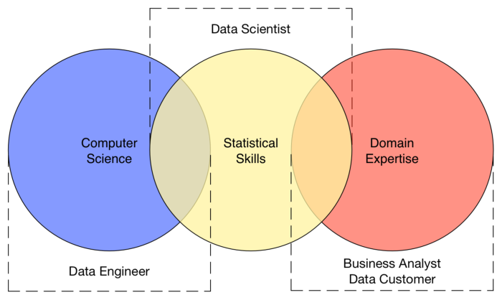
Data Scientist Vs Data Engineer Vs Business Analyst

Slide 10
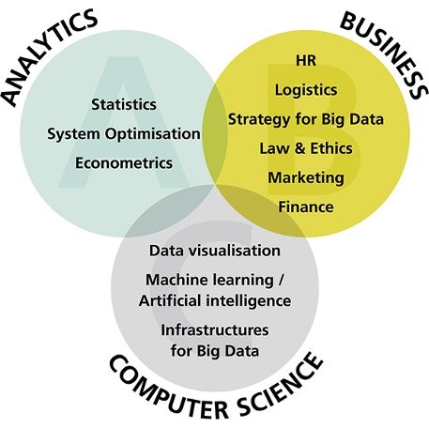
Data Scientist Vs Data Engineer Vs Business Analyst

